Slide 1
Entrepreneurs and Startups
By: Nadine El-Saeed

Slide 2
Before deciding to become an entrepreneur!!!

Slide 3
10 Types of entrepreneur:
The hustler
The small business entrepreneur
The scalable startup entrepreneur
The large company entrepreneur
The innovative entrepreneur
The social entrepreneur
The buyer entrepreneur
The imitator entrepreneur
The cautious entrepreneur
The digital nomad

Slide 4
1. The hustler
Hustlers are willing to work hard with little capital to grow a business they think has potential. Usually, a hustler’s plans will start small and build up over time, but the term can also refer to people who start up a hobby business on the side of their 9-to-5. This might be an Etsy store to sell their crochet art or a freelance writing business to top up their monthly income.
Having a successful side hustle means striking a balance between your work commitments, passions, and home life.
Ex:
Selling online
Dropshipping
freelancing

Slide 5
2. The small business entrepreneur
Is someone who creates a business idea by themselves but plans to expand or franchise in the future. This term often refers to local business owners, like hairdressers, florists, or food trucks operators, but can also mean e commerce operators. The starting goal is often launching a single store, but when the business starts to flourish, the entrepreneur can then start thinking about what’s next.
often born out of a passion for food, beauty, flowers, or whatever else they’re selling, in the hopes the entrepreneur can start a new career in something they love.
Ex:
Nail Salon
Bakery
Vintage store

Slide 6
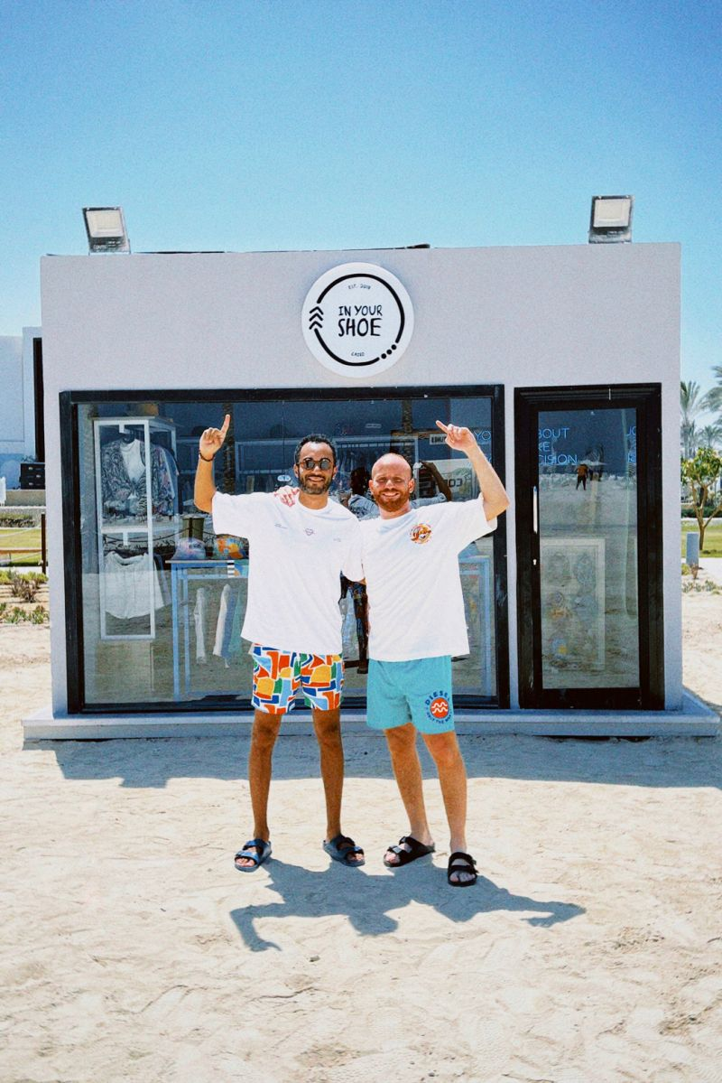


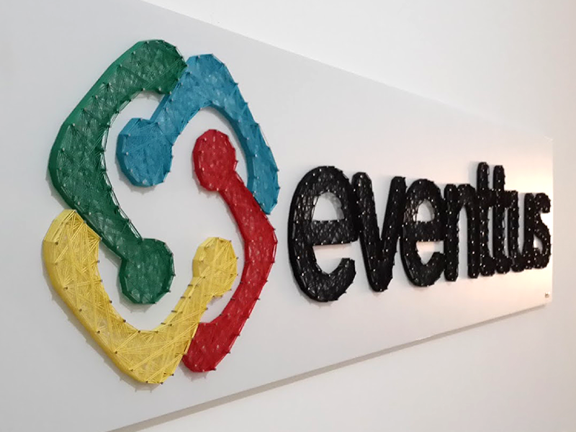

Slide 7


Slide 8
3. The scalable startup entrepreneur
Scalable startup entrepreneurs aim to build a business model that’s expandable. Unlike small business entrepreneurs, scalable startup owners have growth in mind from the very start, even if they come from very humble beginnings. Think of world-famous brands like Amazon, Facebook, and Shopify that all started small with the intention of changing the world.
Ex:
Apps
Digital products or tools
SaaS products

Slide 9


Slide 10
4. The large company entrepreneur
The large company entrepreneur is usually an advanced professional with a lot of business experience. The goal is to create or maintain a company that has multiple lifecycles with the idea of turning existing ideas and products into innovative new offerings. Large company entrepreneurs are constantly creating new services and products based on market demands and are focused on consistent growth.
but small business entrepreneurs can also reach this level if their company grows particularly fast.
Ex:
Selling products or services acquired from existing brands
New branches of a company
Incubation programs to find fresh talent

Slide 11




Slide 12
5. The innovative entrepreneur
Their hope is to come up with a groundbreaking idea that will solve a huge pain point or change an entire industry. Take Uber and Airbnb, for example. The innovator actively seeks out an opportunity to fill a gap in the market and be the first to offer something newer and better.
Ex:
An app to make an existing process easier
A new take on an existing business model
A new piece of wearable technology

Slide 13

RANA EL KALIOUBY – AFFECTIVA

Slide 14


Slide 15
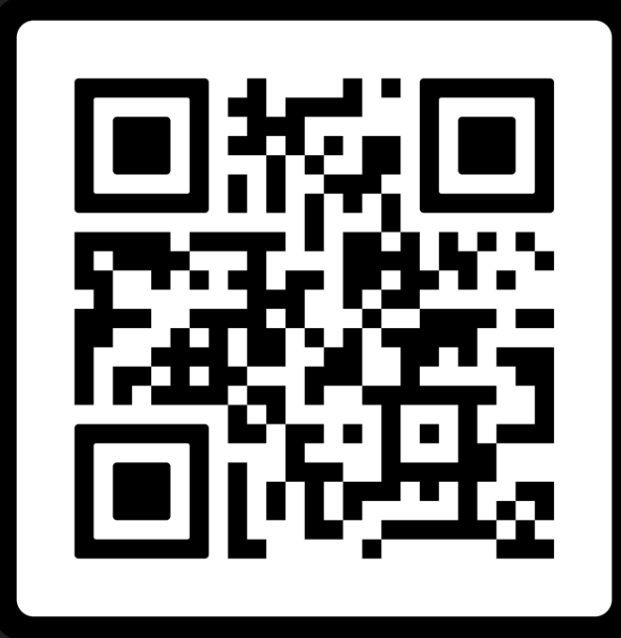

Slide 16
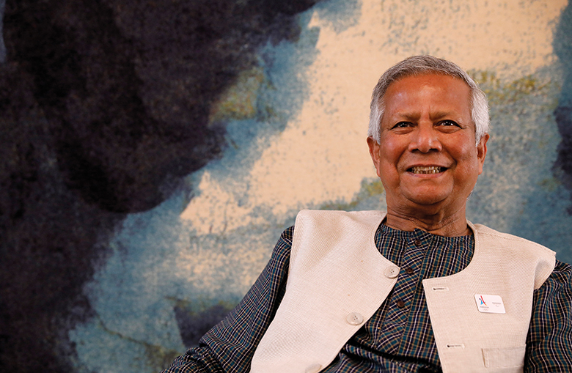

Slide 17
6. The social entrepreneur
Social entrepreneurship is focused on solving social problems and making the world a better place, whether it’s through sustainable products, community initiatives, or charity endeavors. This type of entrepreneur isn’t concerned about big profits or untethered wealth. Instead, they’re committed to working toward social good.
For example, the Grameen Foundation’s founder, Muhammad Yunus, won a Nobel Prize for his business idea. The company is a microfinance organization that helps women get out of poverty through low-interest loans.
Ex:
Educational Service
Eco-friendly products
Apps for local alerts

Slide 18


Slide 19
7. The buyer entrepreneur
Instead of starting their own business or side hustle from scratch, a buyer entrepreneur will invest in other businesses. They’ll either purchase a well-established company and reap the rewards or help develop an existing company to help them thrive.
Don’t confuse this type of entrepreneur with investors or venture capitalists. Buyer entrepreneurship means getting involved in a business both financially and personally. It involves being an active part of growing the bought businesses.
Ex:
Acquiring existing physical companies
Creating an umbrella company with multiple subdivisions
Property investing
App or software acquisition

Slide 20
8. The imitator entrepreneur
Imitation is the greatest form of flattery, and this is the motivation behind imitator entrepreneurship.
Instead of coming up with new ideas, imitator entrepreneurs take inspiration from existing businesses. They don’t completely rip off the idea—they’ll work hard to improve the idea and fill any glaring gaps in the market. Imitators are good at learning from other people’s mistakes to ensure their businesses thrive, and they can come in all shapes and sizes, from a side hustle imitator to a large company imitator.
Ex:
White labeling an existing well-known brand
Replicating an existing product but with extra features
Creating a copycat brand with better marketing

Slide 21
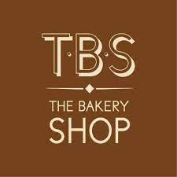




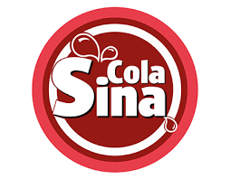

Slide 22
9. The cautious entrepreneur
Also known as researcher entrepreneurs, cautious entrepreneurs take their time when starting and growing a business. They do their due diligence, carry out research, and only go ahead with their plans when they’re certain they’ll succeed.
Cautious entrepreneurs rely on facts, data, and logic and will often create detailed business plans before getting started.
Examples of businesses a cautious entrepreneur can start can vary wildly—the differentiation is in the process they use to get started. Instead of diving in headfirst, this type of entrepreneur will spend months or years researching their market, product fit, and game plan.

Slide 23

10. The digital nomad
While many of the entrepreneurs listed here have the luxury of working from wherever they want, digital nomads make it a critical part of their business plan. They create businesses that they can work on anywhere, anytime, from a beach in Barbados to the bustling city streets of Tokyo.
The goal is the freedom to travel as much as possible. Most digital nomads run businesses from their laptops and often use skills like copywriting, designing, coaching, and teaching to earn money.
Chris Cage, founder of Greenbelly Meals, started his business as a digital nomad in Thailand and grew it while traveling the world.
Ex:
Web development
Teaching
Course creation
Coaching
Ecommerce brand

Slide 24
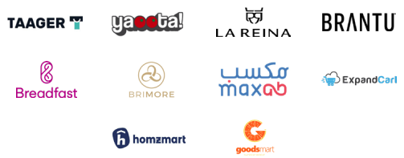
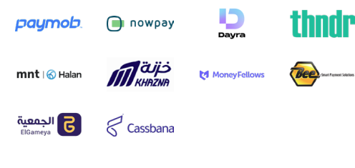

Slide 25
Resources
https://mcit.gov.eg/Upcont/Documents/Reports%20and%20Documents_26102021000_Egyptian-Startup-Ecosystem-Report-2021.pdf
https://www.aucegypt.edu/news/stories/global-report-entrepreneurship-egypt-growing-popularity
https://www.pfh-university.com/blog/9-types-entrepreneurship#:~:text=They%20often%20receive%20funding%20from,are%20Facebook%2C%20Instagram%20and%20Uber.
https://falakstartups.com/
https://www.basetemplates.com/startups/top-8-startups-in-cairo
https://thestartupscene.me/MenaEcosystems/These-13-Egyptian-Startups-Just-Made-Forbes-Top-100-in-the-Middle-East
https://egyptinnovate.com/en/news/linkedin-list-top-startups-2022-egypt
https://www.entrepreneur.com/en-ae/growth-strategies/success-story-eventtus-co-founder-and-ceo-mai-medhat-on/380284

